Slide 1

Mid Year Check – In 2025
ENGINEERING / THE DIGITAL TRANSFORMATION COMPANY
Choose language \ Scegli la lingua
ENGLISH
ITALIANO

Slide 2

Mid Year Check 2025 – Workday User Manual
ENGINEERING / THE DIGITAL TRANSFORMATION COMPANY
For internal use only
July 2025

Slide 3
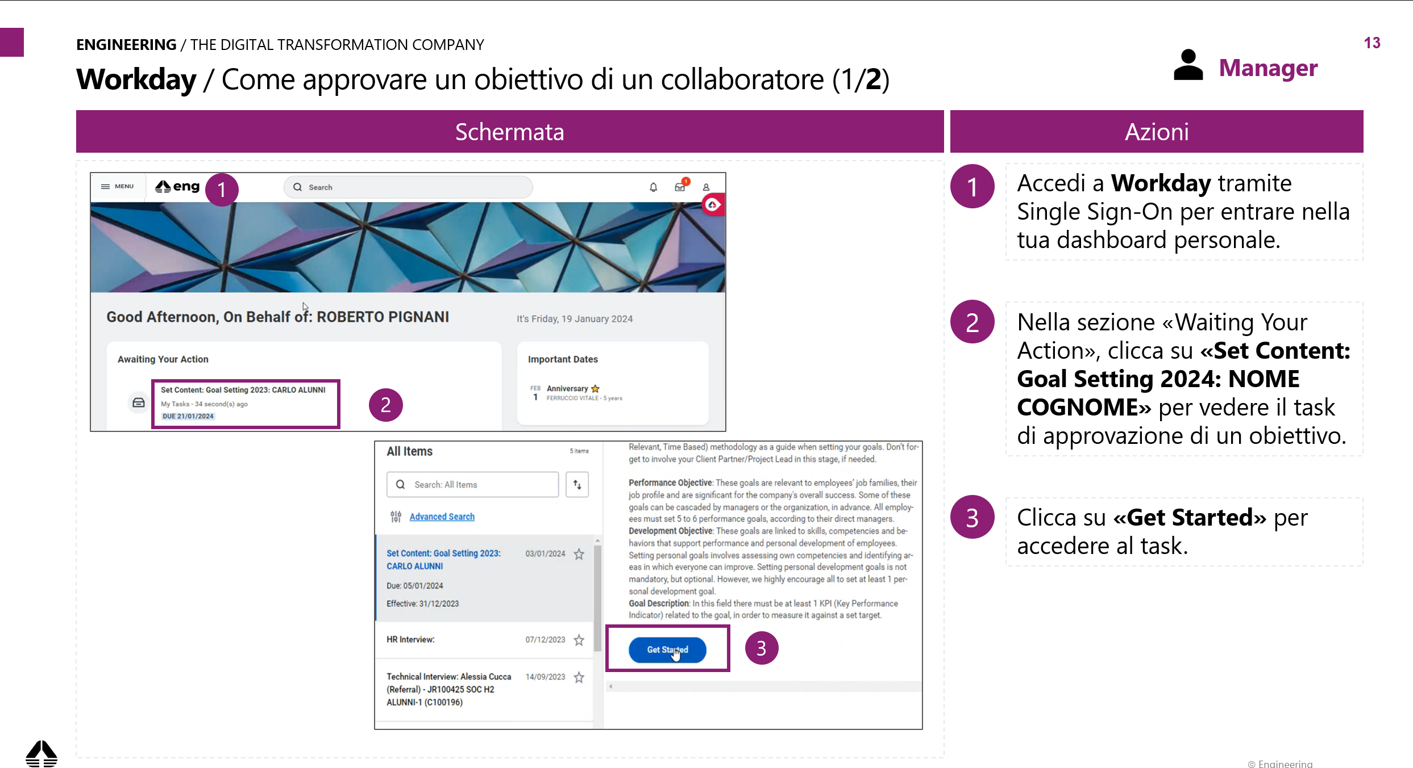
Introduction / How to read this manual: process and step-by-step system guide
ENGINEERING / THE DIGITAL TRANSFORMATION COMPANY
The scope of this document is to provide the tools and knowledge needed to use the new Workday platform for the Mid Year Check-In.
See the reference screen to the left of the slide.
Note: name-related information in the screenshots is provided for illustrative purposes.
On the right of the slide, you can see the description of the steps to proceed in the process/functionality.

Slide 4
Agenda Workday Tasks
ENGINEERING / THE DIGITAL TRANSFORMATION COMPANY
Employee – Self Evaluation
Manager – Get Additional Manager Evaluation
Additional Manager – Additional Manager Evaluation
Manager – Manager Evaluation & To Do
Employee – Acknowledgement
FAQs

Slide 5

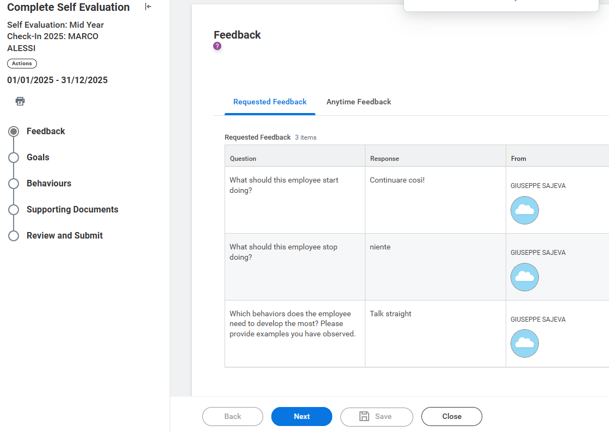
Mid Year Check – In / Self Evaluation (2/5)
ENGINEERING / THE DIGITAL TRANSFORMATION COMPANY
Employee
Screen
Actions
1
The self-assessment form is divided into several sections:
Feedback
Goals
Behaviours
Supporting Documents
Review and Submit
2
3
1
2
In the section "Feedback" you can view all the feedback requested both outside and during the Mid Year Check – In phase.
Mario Rossi
Mario Rossi
3
«Request Feedback»: You can find all the feedback you receive from people during the year, which you can also find in your personal profile under the "Feedback" section
Mario Rossi
4
4
«Feedback from Review»: you will find all the feedback provided by the Additional Manager (if present or other relevant stakeholder) during the Mid Year Check – In phase.
5
Click "Next" to move forward to the other sections.

Slide 6
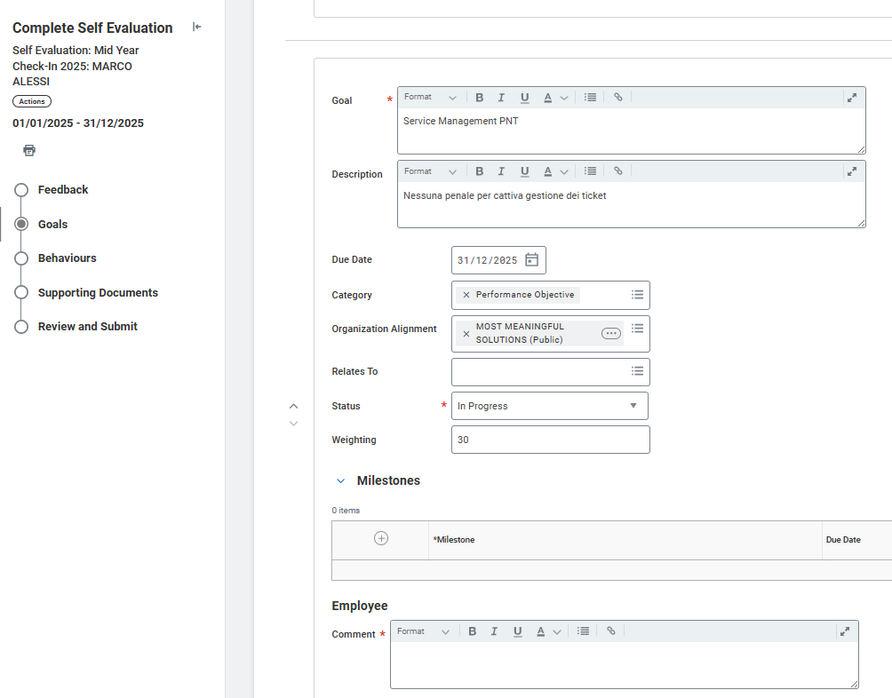
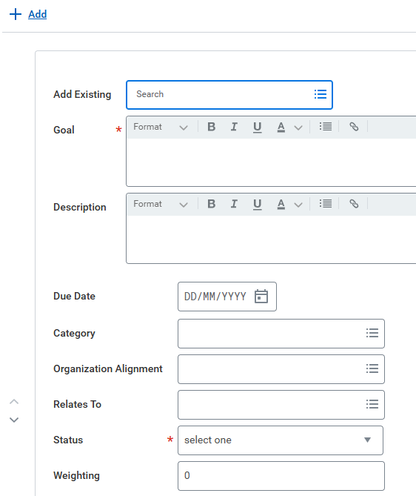
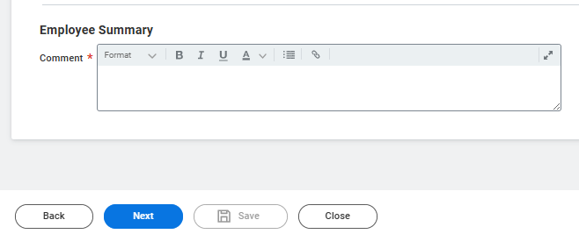
Mid Year Check – In / Self Evaluation (3/5)
ENGINEERING / THE DIGITAL TRANSFORMATION COMPANY
Employee
Screen
Actions
1
1
In the section "Goals" you will find all the goals entered during the Goal Setting phase.
During the Mid-Year Check - In is asked to:
update the "Status" of each individual goal
verify that the sum of all the goals is 100%
enter a comment about each goal in the "Comment" field and short recap in the “Employee Summary”
Goal # 1
KPIs # 1
2
2
If it was not possible to enter goals during the Goal Setting window, the fields on the tab will be empty and therefore you will be able to enter all the details of the goals here by clicking “Add”
You have to fill the following fields:
Category (Perfomance/Development)
Goal (name)
KPI/Target
Due Date
Organizational Alignment
Status
Weighting
Goal comment # 1
General comment

Slide 7
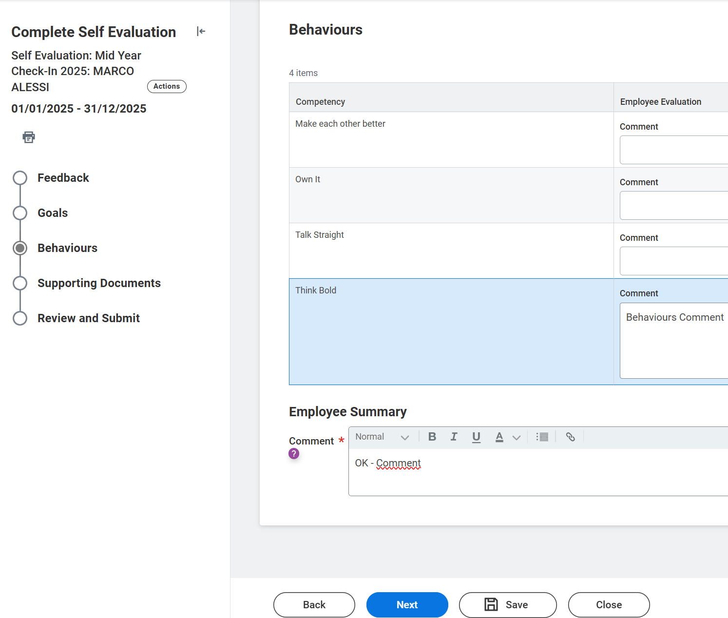
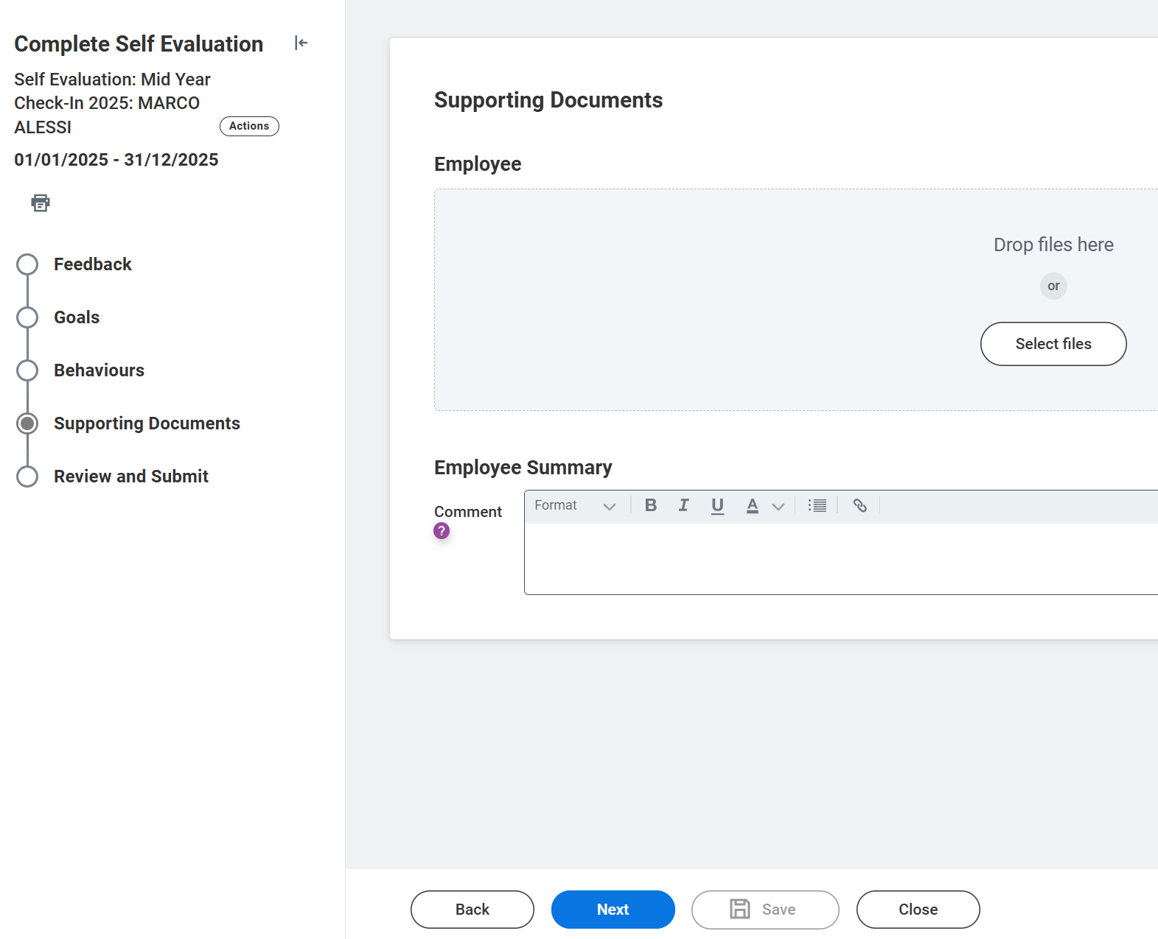
Mid Year Check – In / Self Evaluation (4/5)
ENGINEERING / THE DIGITAL TRANSFORMATION COMPANY
Employee
Screen
Actions
1
In the section "Behaviours" you can comment on each individual object in the "Employee Evaluation" column and enter an overall comment in the "Employee Summary“ field (required).
1
2
Select "Next" to move forward to the other sections.
3
In the “Supporting Documents” section, if needed, you can upload a document to support your evaluation and provide a comment about it.
4
Click “Next” to continue
1
2
3
4

Slide 8
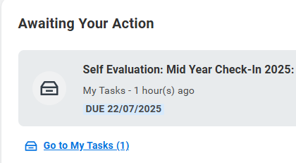
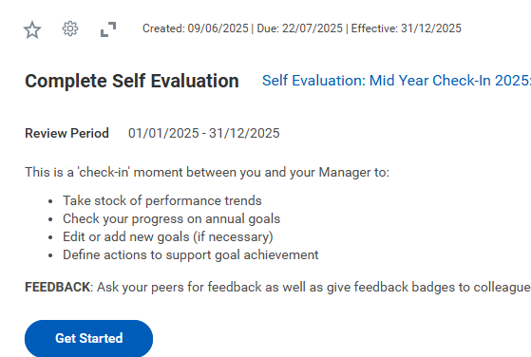
Mid Year Check – In / Self Evaluation (1/5)
ENGINEERING / THE DIGITAL TRANSFORMATION COMPANY
Employee
Screen
Actions
1
1
In the "Awaiting Your Action" section, click on the task "Self Evaluation Mid Year Check-In 2025: Name and Surname"
2
Select "Get Started" to start your evaluation.
2

Slide 9
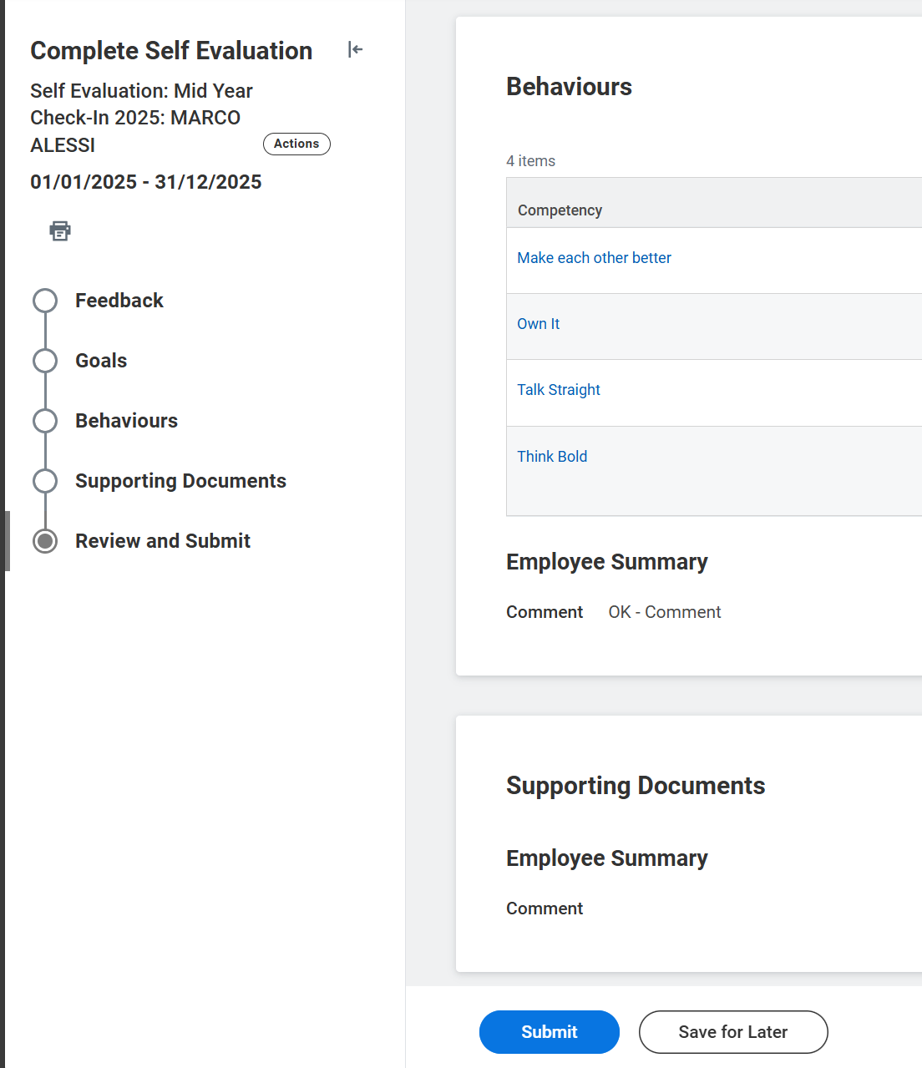
Mid Year Check – In / Self Evaluation (5/5)
ENGINEERING / THE DIGITAL TRANSFORMATION COMPANY
Employee
Screen
Actions
1
The last section "Review and Submit" summarizes all the changes made in the previous tabs.
2
Click "Submit" to submit your self-assessment and close the task.
1
2

Slide 10
Agenda
ENGINEERING / THE DIGITAL TRANSFORMATION COMPANY
Employee – Self Evaluation
Manager – Get Additional Manager Evaluation
Additional Manager – Additional Manager Evaluation
Manager – Manager Evaluation & To Do
Employee – Acknowledgement
FAQs

Slide 11

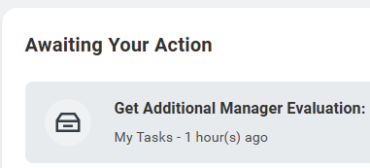
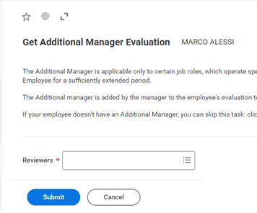
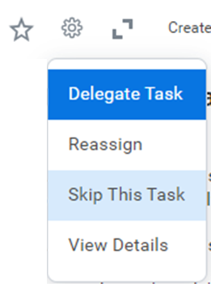
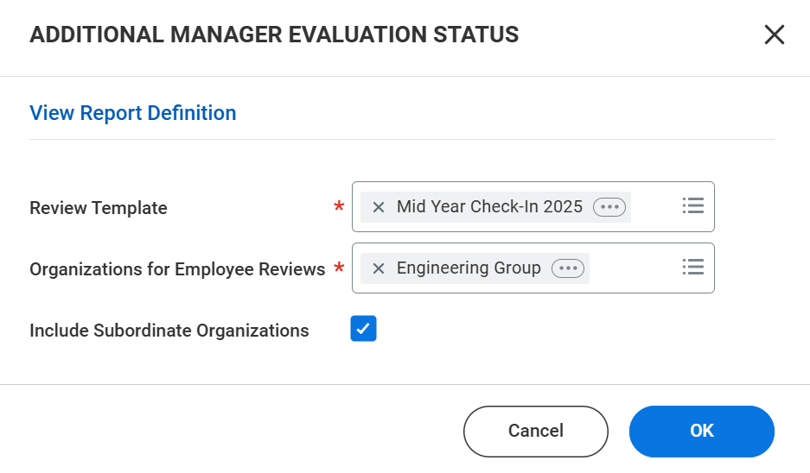
Mid Year Check – In / Get Additional Manager Evaluation
ENGINEERING / THE DIGITAL TRANSFORMATION COMPANY
Manager
Screen
Actions
1
4
1
Once the employee has submitted the Self Evalution task, you will receive a task called “Get Additional Manager Evaluation”
2
Choose from the drop-down menu or type in the name of the person you want to nominate as Additional Manager.
2
3
Click “Submit” to send the request.
3
4
If your Employee does not need an additional manager, you can skip this task by clicking on the cog icon “Skip this Task” and click “Submit”
5
Note: This task is not mandatory. Even if feedback is requested from the Additional Manager or the task is skipped, the Manager immediately receives the manager evaluation task. Therefore, the Manager does not need to wait for the Additional Manager's evaluation before proceeding with their own.
5
To monitor whether the additional manager has given feedback, you can use the report "Additional Manager Evaluation Status" and select Mid Year Check - In 2025 and your supervisory organisation.

Slide 12
Agenda
ENGINEERING / THE DIGITAL TRANSFORMATION COMPANY
Employee – Self Evaluation
Manager – Get Additional Manager Evaluation
Additional Manager – Additional Manager Evaluation
Manager – Manager Evaluation & To Do
Employee – Acknowledgement
FAQs

Slide 13

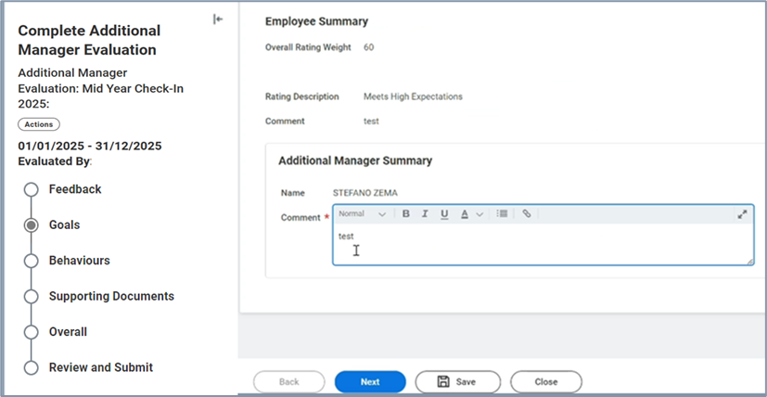
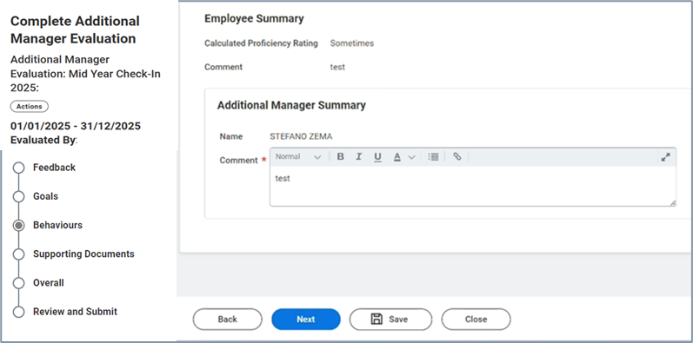
Mid Year Check – In / Additional Manager Evaluation (2/3)
ENGINEERING / THE DIGITAL TRANSFORMATION COMPANY
Additional Manager
Screen
Actions
1
In the “Goal" section, you have to provide the overall comment about the employee's goals in the “Additional manager summary” section at the bottom.
1
2
Click “Next“ to continue.
3
In the “Behaviours" section, you have to provide the overall comment about the employee’s behaviours in the “Additional manager summary” section at the bottom
2
4
Click “Next“ to continue.
3
4

Slide 14
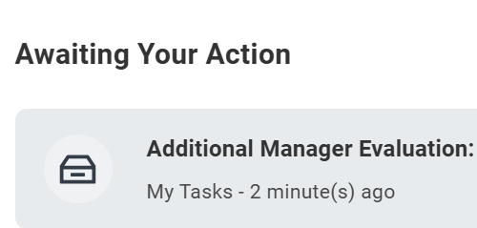
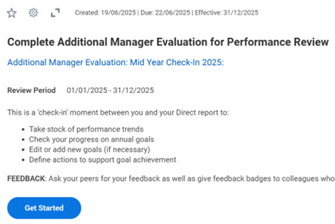
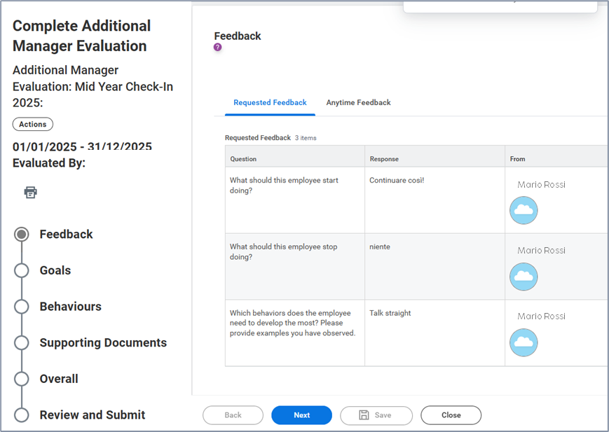
Mid Year Check – In / Additional Manager Evaluation (1/3)
ENGINEERING / THE DIGITAL TRANSFORMATION COMPANY
Additional Manager
Screen
Actions
1
1
Log in to Workday via single sign-on to access your personal dashboard.
In the "Awaiting Your Action" section, click on “Complete Get Additional Manager Evaluation”.
Click “Get Started“ to start with the evaluation.
2
The template is divided into several sections:
Feedback
Goals
Behaviours
Supporting Documents
Overall
Review and Submit
2
3
In the “Feedback” section you can find all the feedback received by the employee over the past year.
3
4
Click “Next“ to continue.
4

Slide 15
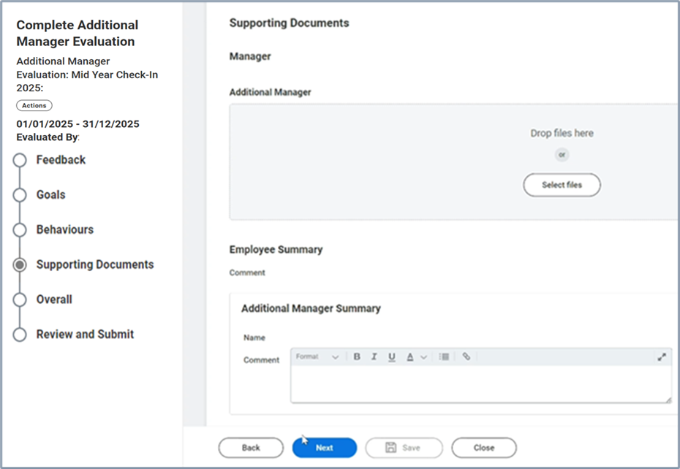
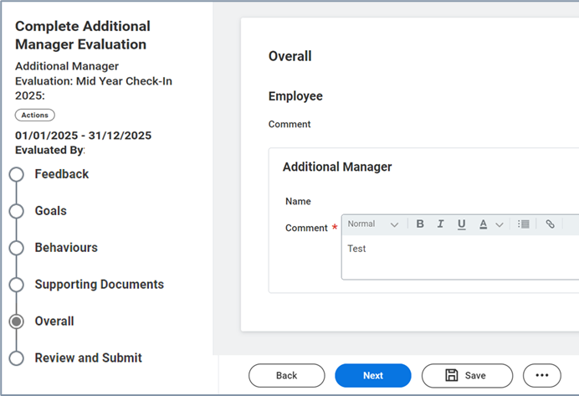
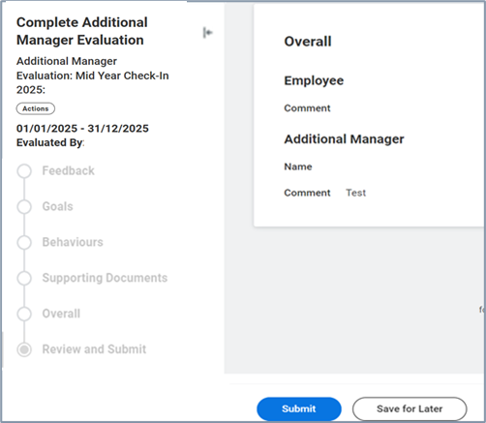
Mid Year Check – In / Additional Manager Evaluation (3/3)
ENGINEERING / THE DIGITAL TRANSFORMATION COMPANY
Additional Manager
Screen
Actions
1
In the “Supporting Documents" section, you can upload a document to support the evaluation and provide a comment on it, if necessary.
2
Click “Next“ to continue.
1
3
In the “Overall” you have to provide an overall comment about Employee’s evaluation.
3
4
Click “Next“ to continue.
2
4
5
In the “Review and Submit” section you can review the evaluation.
Click "Submit" to submit the evaluation and close the task.
5

Slide 16
Agenda
ENGINEERING / THE DIGITAL TRANSFORMATION COMPANY
Employee – Self Evaluation
Manager – Get Additional Manager Evaluation
Additional Manager – Additional Manager Evaluation
Manager – Manager Evaluation & To Do
Employee – Acknowledgement
FAQs

Slide 17

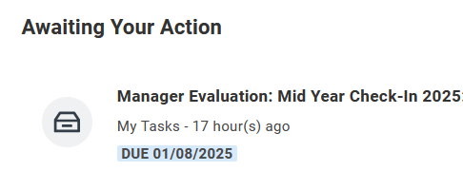
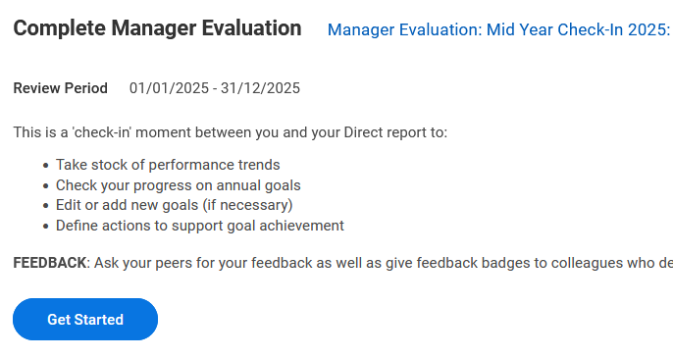
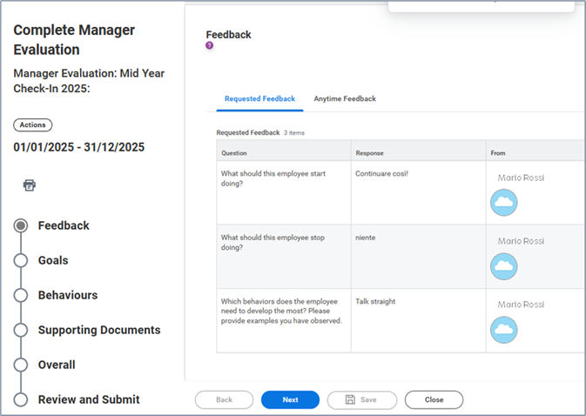
Mid Year Check – In / Manager Evaluation (1/4)
ENGINEERING / THE DIGITAL TRANSFORMATION COMPANY
Manager
Screen
Actions
1
1
Log in to Workday via single sign-on to access your personal dashboard.
In the "Awaiting Your Action" section, click on “Manager Evaluation: Mid Year Check - In“.
Click “Get Started“ to start with the evaluation.
2
3
The Manager Evaluation is divided into several sections:
Goals
Behaviours
Supporting Documents
Feedback
Overall
Review and Submit
2
3
4
In the “Feedback” section you can find all the feedback received by the employee over the past year.
Click “Next” to continue
4

Slide 18
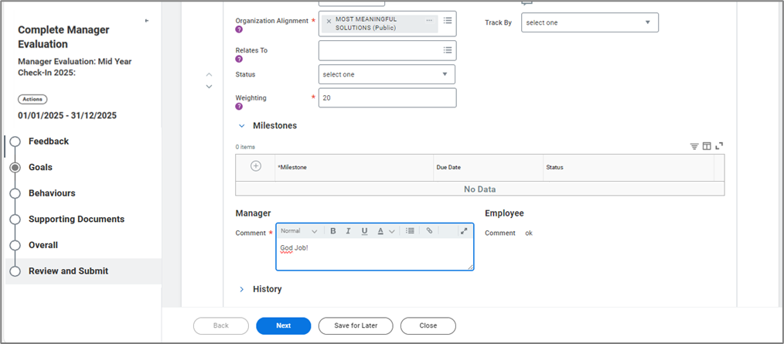
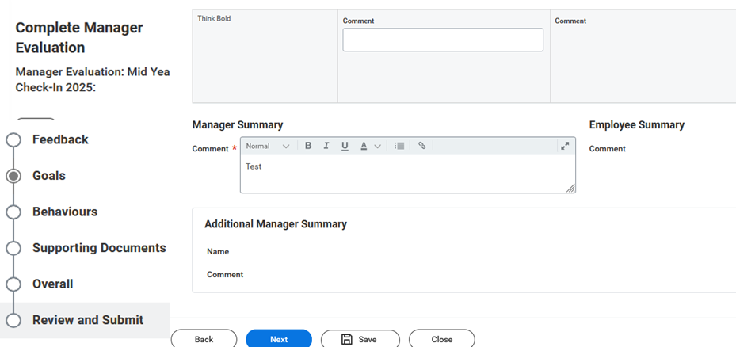
Mid Year Check – In / Manager Evaluation (2/4)
ENGINEERING / THE DIGITAL TRANSFORMATION COMPANY
Manager
Screen
Actions
1
In the “Goal" section, you have to provide the overall comment about the employee's goals in the “Manager summary” section at the bottom.
2
Click “Next“ to continue.
1
3
In the “Behaviours" section, you have to provide the overall comment about the employee’s behaviours in the “Manager summary” section at the bottom
2
4
Click “Next“ to continue.
3
4

Slide 19
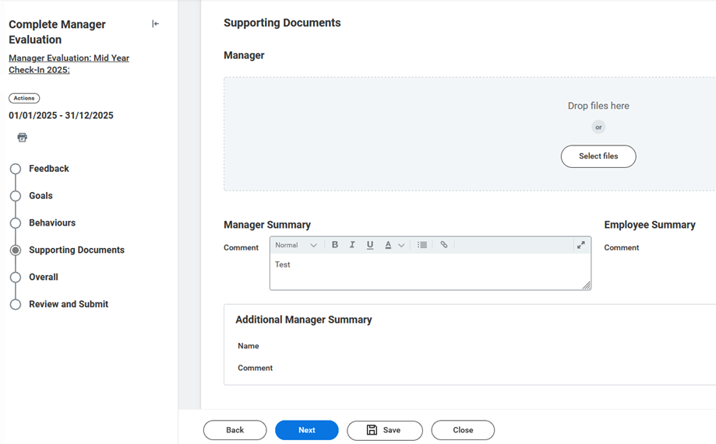
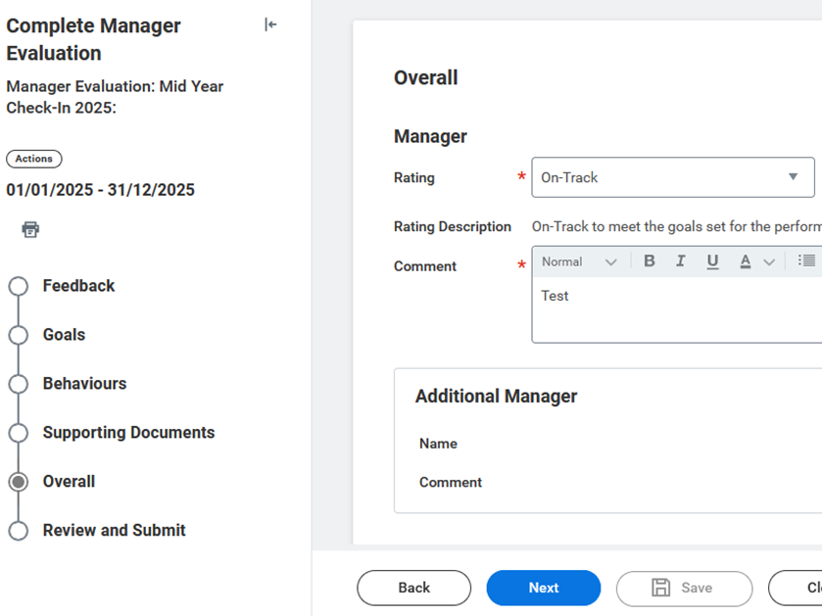
Mid Year Check – In / Manager Evaluation (3/4)
ENGINEERING / THE DIGITAL TRANSFORMATION COMPANY
Manager
Screen
Actions
1
In the “Supporting Documents” section, if needed, you can:
you can consult the documentation uploaded by the Employee or/and Additional manager, if any
upload a document to support the evaluation and provide a comment on it, if necessary.
Click “Next“ to continue.
1
2
In the "Overall" section, it is necessary to select the rating of the Employee, selecting between:
On – Track: in line with expectations
Off – Track: Not in line with expectations
The rating gives an indication of the trend in performance and behaviour for this first part of the year.
2
3
3
In addition to the rating, it is necessary to include a summary comment of the rating.
4
4
Click “Next“ to continue.

Slide 20
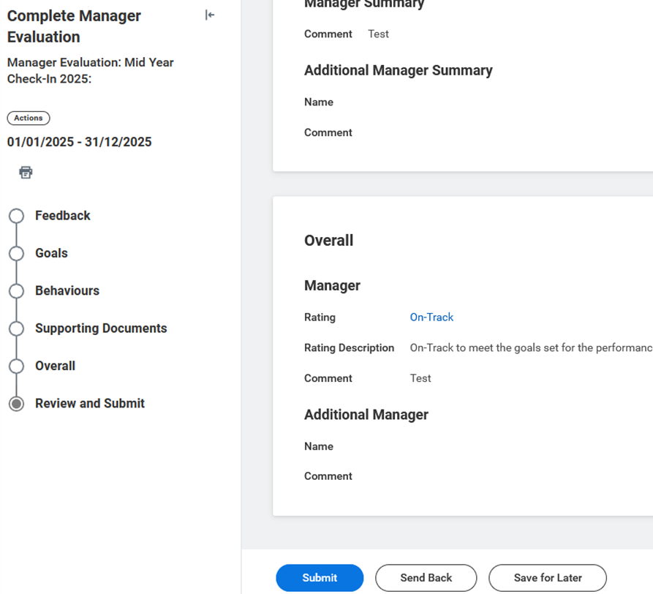
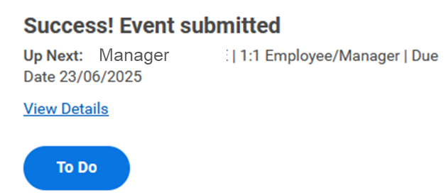
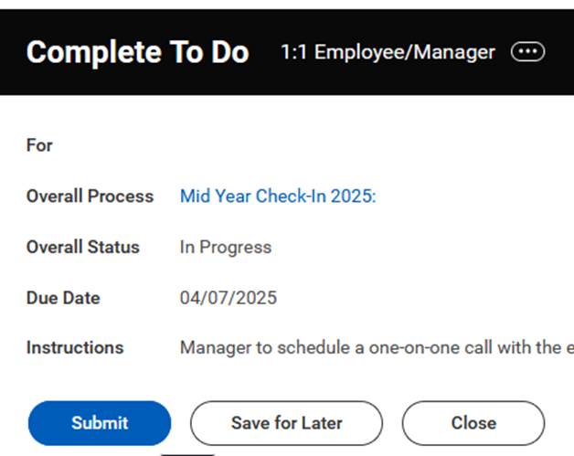
Mid Year Check – In / Manager Evaluation (4/4)
ENGINEERING / THE DIGITAL TRANSFORMATION COMPANY
Manager
Screen
Actions
1
The last section "Review and Submit" summarizes all the changes made in the previous tabs.
2
Click "Submit" to submit your evaluation and close the task.
3
Following the Manager Evaluation, click "To Do" to open the notification and display the task "To Do – 1:1 Employee/Manager"
3
4
Click "Submit" to send the evaluation to the Employee in view.
1
2
4

Slide 21
Agenda
ENGINEERING / THE DIGITAL TRANSFORMATION COMPANY
Employee – Self Evaluation
Manager – Get Additional Manager Evaluation
Additional Manager – Additional Manager Evaluation
Manager – Manager Evaluation & To Do
Employee – Acknowledgement
FAQs

Slide 22

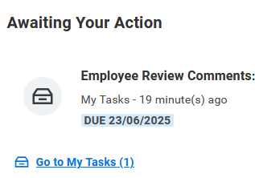
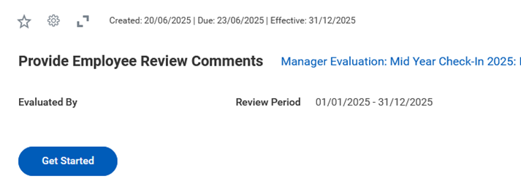
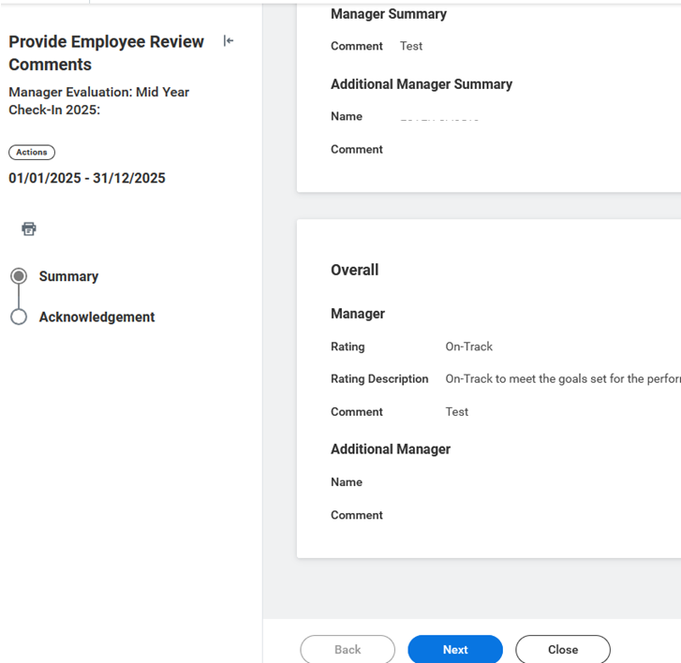
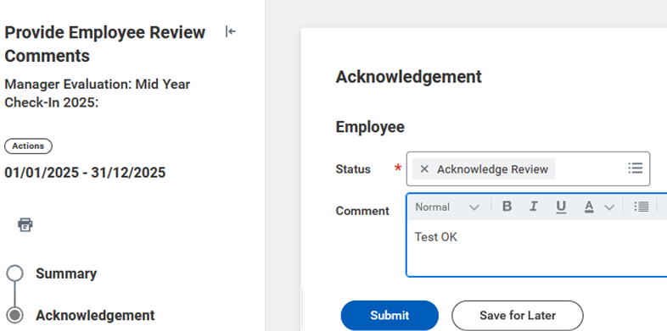
Mid Year Check – In / Employee Acknowledgement
ENGINEERING / THE DIGITAL TRANSFORMATION COMPANY
Employee
Screen
Actions
1
Log in to Workday via single sign-on to access your personal dashboard.
In the "Awaiting Your Action" section, click on “Employee Review Comments: Mid Year Check – In”
Click “Get Started“ to start with the evaluation.
1
2
In the tab “Summary”, you can view all the comments left by the Manager and Additional Manager (if present)
Click “Next” to continueì
3
3
Select in “Status” "Acknowledgement Review" and enter your overall comment, if necessary.
4
4
Click “Submit” to accept the evaluation.
The Mid Year Check – In now is completed.
2

Slide 23
Agenda
ENGINEERING / THE DIGITAL TRANSFORMATION COMPANY
Employee – Self Evaluation
Manager – Get Additional Manager Evaluation
Additional Manager – Additional Manager Evaluation
Manager – Manager Evaluation & To Do
Employee – Acknowledgement
FAQs

Slide 24
Mid Year Check – In / FAQs (1/3)
ENGINEERING / THE DIGITAL TRANSFORMATION COMPANY
Topic | Domanda | Risposta
Goals Visualization (Employee) | I don't have any goal loaded into the system, what should I do? | You will have to enter the objectives agreed with the Manager directly in the «Self Evaluation: Mid Year Check-In» task
 | I have updated my goals in the Self Evaluation, when will I see them in my dashboard? | The updated goals will only be visible at the conclusion of the Mid Year Check-In process, after you have submitted "Acknowledgement“ task. You will see your updated goal in your profile Performance > Goals
 | There are "Cascade" goals in my card that are not applicable to me. Can I change or delete them? | You can change them if they have been set as such by the cascader. You will first need to align your Manager with your change request. In your "Self Evaluation" tab you can then do this, selecting "Not Applicable" as the status, weight 0 and entering a comment to justify your action.
 | I have development goals that are not currently applicable, what should I do? | You can proceed to update the goal directly in your Self Evaluation by selecting "Not Started" as the status and entering a comment to motivate it. To add another development goal, you can click on "Add" and create a new one. Remember to make sure that the total weights are equal to 100.
 | I have just joined Eng Group, what should I do? Do I have to enter goals and do the Mid Year Check – In? | If you were hired after 03/07 ou will have to enter your goals in the Mid Year Check – In: Self Evaluation task after agreeing them with your Manager.
Self Evaluation (Employee) | I made a mistake in filling out my self evaluation. How do I go back? | Only the Manager has the possibility to "Send Back" the received form and send it back. In case of an error, we recommend that you notify the Manager as soon as possible so that he can send the card back to you.
 | I asked another person for feedback, but it is not visible in my Self Evaluation, why? | Feedback entered by selecting the "Private" option is not visible in the Mid Year check-in tab. We recommend that you request feedback by specifying that it is visible.
 | I have completed my Self Evaluation form, but my Manager has not received the Manager Evaluation task to evaluate me. Did I do something wrong? | If your Manager does not see the "Manager Evaluation" task, it is because the "Get Additional Manager Evaluation" task has not been completed or skipped. Only after requesting feedback, the Manager will be able to view the task to evaluate you.

Slide 25
Mid Year Check – In / FAQs (2/3)
ENGINEERING / THE DIGITAL TRANSFORMATION COMPANY
Topic | Domanda | Risposta
Get Additional Manager Evaluation | Is it possible to request feedback from multiple people in the Get Additional Manager Feedback task? | Yes, you can choose more people.
 | Can I request feedback from a customer or third party outside the company? | You can request customer feedback for your people outside the system and attach it in the "Supporting Documents" section.
 | There has been a reorganization of the Organizational Unit and I am no longer that person's Manager. Can I reassign the task to the correct Manager? | You can reassign the task to the correct person by selecting "Reassign" and entering the reason for the request. This will then be verified by HRBP and Talent Admin before being approved.
 | I requested feedback from the wrong person and I no longer see the task—how can I cancel the request? | If you mistakenly assigned the 'Get Additional Manager Evaluation' task to the wrong person, please note that since this is a non-mandatory task, it cannot be canceled or recalled. As a Manager, you can directly inform the person who received the request by mistake, explaining that no action is required on their part. If you wish to request feedback from the correct person instead, you can do so using the 'Get Feedback on Worker' task.
 | I requested feedback for one of my workers directly from the "Feedback" section, but the Mid Year task is still not completed. Can I skip this task or not? | In this case, you can skip this task by clicking on "Skip task" to go to the next step. The important thing is that each person has received at least one useful feedback for the evaluation.
 | I received a task by mistake to give feedback to someone—how can I decline it? | If you received the Get Additional Manager Feedback task by mistake, please note that since it is a non-mandatory task, it cannot be canceled or recalled. You can simply ignore it and, if needed, inform the person who assigned it to you about the error.

Slide 26
Mid Year Check – In / FAQs (3/3)
ENGINEERING / THE DIGITAL TRANSFORMATION COMPANY
Topic | Domanda | Risposta
Manager Evaluation | Once I have completed the assessment, should I immediately schedule a meeting with the person? | Each Manager is required to schedule an individual moment with each person on their team. The meeting can be held once the review has been completed with the summary rating "on track – off track“.
 | I completed the "Manager Evaluation" task and received the "To Do 1:1" task. Do I have to click "Submit" immediately? | Clicking "Submit" will send the rating to the person and it will no longer be possible to edit it. We suggest to first have the 1:1 meeting with the person and then click "Submit".
 | I accidentally submitted the Manager Evaluation—how can I go back? | If you mistakenly submitted the Manager Evaluation for the Mid Year Check-In 2025, unfortunately, it is not possible to revert it on your own once the form has been submitted. In such cases, you’ll need to open a ticket on AZIZ to request support in resetting the task to the Manager Evaluation step. Please note that this action is only taken in cases where the form was not completed or contains significant errors.
Report | What reports can I use to track the progress of my team's Mid Year process? | From the “Talent & Performance Management" dashboard by selecting “Mid Year Check – In" and filtering by Mid Year Check – In 2025 you will be able to view the following dashboards: Performance Review Status: details of how many evaluations have been completed or are in progress Performance Review Status – Action Required: a report that shows where the assessments are in the process. My Team’s Performance Reviews: recap report to display the Manager rating "On Track – Off Track"
 | How do I see all feedback given and received from my team? | You can view all the feedback given and received from the people on your team by writing in the search bar "Feedback Summary"
 | Is there a report that shows me the status of the Feedback request? | You can use «Additional Manager Evaluation Status» report by typing in the search bar
 | How should I manage people who have resigned? | You don't have to do anything right now and you can leave the task "pending".

Slide 27
Thank you
ENGINEERING / THE DIGITAL TRANSFORMATION COMPANY

Slide 28
Mid Year Check 2025 – Workday Manuale Utente
ENGINEERING / THE DIGITAL TRANSFORMATION COMPANY
For internal use only
Luglio 2025

Slide 29
Introduzione / Come leggere il presente manuale: guida step by step a sistema
ENGINEERING / THE DIGITAL TRANSFORMATION COMPANY
Lo scopo di questo documento è quello di fornire gli strumenti utili e la conoscenza necessaria per utilizzare la piattaforma di Workday nell’ambito del processo di Mid Year Check – In.
Vedi a destra della slide la descrizione degli step da effettuare per procedere nel processo/funzionalità.
Vedi la schermata di riferimento a sinistra della slide.
Nota: le informazioni legate ai nominativi nelle schermate sono presenti a titolo illustrativo

Slide 30
Agenda Workday Tasks
ENGINEERING / THE DIGITAL TRANSFORMATION COMPANY
Employee – Self Evaluation
Manager – Get Additional Manager Evaluation
Additional Manager – Additional Manager Evaluation
Manager – Manager Evaluation & To Do
Employee – Acknowledgement
FAQs

Slide 31
Mid Year Check – In / Self Evaluation (1/5)
ENGINEERING / THE DIGITAL TRANSFORMATION COMPANY
Employee
Screen
Actions
1
1
Nella sezione "Awaiting Your Action", clicca sul task "Self Evaluation Mid Year Check-In 2025: Name and Surname"
2
Seleziona "Get Started" per iniziare la tua valutazione.
2

Slide 32
Mid Year Check – In / Self Evaluation (2/5)
ENGINEERING / THE DIGITAL TRANSFORMATION COMPANY
Employee
Screen
Actions
1
La self –evaluation è composta dalle seguenti sezioni:
Feedback
Goals
Behaviours
Supporting Documents
Review and Submit
2
3
1
2
Nella sezione "Feedback" è possible visualizzare tutti I feedback richiesti priam e durante la finestra di Mid Year Check – In.
Mario Rossi
Mario Rossi
3
«Request Feedback»: puoi trovare tutti i feedback ricevuti dalla persone.
Mario Rossi
4
«Feedback from Review»: puoi trovare i feedback dati dall’Additional Manager (se presenti).
4
5
Clicca “Next” per passare alla sezione successive.

Slide 33
Mid Year Check – In / Self Evaluation (3/5)
ENGINEERING / THE DIGITAL TRANSFORMATION COMPANY
Employee
Screen
Actions
1
1
Nella sezione "Goals" troverai tutti gli obiettivi inseriti durante la fase di Goal Setting.
Durante la Mid-Year Check - In devi:
Aggiornare il "Status" di ogni singolo obiettivo
verificare che la somma di tutti gli obiettivi sia 100%
Inserire un commento su ogni obiettivo nella sezione "Comment" e breve riassunto nel “Employee Summary”
Goal # 1
KPIs # 1
2
2
Se non è stato possibile inserire gli obiettivi durante la finestra di Goal Setting, puoi cliccare "Add" per inserire il nuovo obiettivo e compilare tutti i campi.
È necessario compilare i seguenti campi:
Category (Perfomance/Development)
Goal (name)
KPI/Target
Due Date
Organizational Alignment
Status
Weighting
Goal comment # 1
General comment

Slide 34
Mid Year Check – In / Self Evaluation (4/5)
ENGINEERING / THE DIGITAL TRANSFORMATION COMPANY
Employee
Screen
Actions
1
Nella sezione "Behaviours“ è possibile commentare ogni singolo oggetto nel "Employee Evaluation" e inserisci un commento generale nel "Employee Summary“(Obbligatorio).
2
Seleziona "Next" per passare alle altre sezioni.
1
2

Slide 35
Mid Year Check – In / Self Evaluation (5/5)
ENGINEERING / THE DIGITAL TRANSFORMATION COMPANY
Employee
Screen
Actions
1
Nel“Supporting Documents”, se necessario, puoi caricare un documento a supporto della tua valutazione e fornire un commento a riguardo.
2
Clicca “Next” per continuare.
1
1
3
L'ultima sezione"Review and Submit" riepiloga tutte le modifiche apportate nelle schede precedenti.
3
4
Clicca "Submit" per inviare la tua autovalutazione e chiudere l'attività.
2
3

Slide 36
Agenda
ENGINEERING / THE DIGITAL TRANSFORMATION COMPANY
Employee – Self Evaluation
Manager – Get Additional Manager Evaluation
Additional Manager – Additional Manager Evaluation
Manager – Manager Evaluation & To Do
Employee – Acknowledgement
FAQs

Slide 37
Mid Year Check – In / Get Additional Manager Evaluation
ENGINEERING / THE DIGITAL TRANSFORMATION COMPANY
Manager
Screen
Actions
1
4
1
Una volta che la persona ha sottomesso la propria Self Evalution task, come Manager riceverai il task “Get Additional Manager Evaluation”
2
Scegli dal menu a tendina il nome della persona che vuoi nominare come Additional Manager.
2
3
Clicca “Submit” per inviare la richiesta.
3
4
Se la persona non ha bisogno di una valutazione da parte di un Additional Manger puoi saltare questo task cliccando sull’icona delle impostazioni “Skip this Task” e cliccando “Submit”
5
Note: Questo task non è obbligatorio. Anche se viene richiesto il feedback all'Additional Manager o il task viene saltato, il Manager riceve immediatamente il task di valutazione. Pertanto, il Manager non deve necessariamente attendere la valutazione dell'Additional Manager per procedere con la propria.
5
Per monitorare se Additional Manager ha dato la sua valutazione, è possible usare il report "Additional Manager Evaluation Status" e selezionando Mid Year Check - In 2025 e la tua supervisory organization.

Slide 38
Agenda
ENGINEERING / THE DIGITAL TRANSFORMATION COMPANY
Employee – Self Evaluation
Manager – Get Additional Manager Evaluation
Additional Manager – Additional Manager Evaluation
Manager – Manager Evaluation & To Do
Employee – Acknowledgement
FAQs

Slide 39
Mid Year Check – In / Additional Manager Evaluation (1/3)
ENGINEERING / THE DIGITAL TRANSFORMATION COMPANY
Additional Manager
Screen
Actions
1
1
Accedi a Workday tramite Single Sign-On per visualizzare la tua dashboard personale. Nella sezione "Awaiting Your Action", clicca “Complete Get Additional Manager Evaluation”.
Clicca “Get Started“ per iniziare con la valutazione.
2
Il template è suddiviso in diverse sezioni:
Feedback
Goals
Behaviours
Supporting Documents
Overall
Review and Submit
2
3
Nella sezione "Feedback" puoi trovare tutti i feedback ricevuti dal dipendente nell'ultimo anno.
3
4
Clicca su “Next“ per continuare.
4

Slide 40
Mid Year Check – In / Additional Manager Evaluation (2/3)
ENGINEERING / THE DIGITAL TRANSFORMATION COMPANY
Additional Manager
Screen
Actions
1
Nella sezione“Goal" section, devi fornire il commento generale sugli obiettivi della persona nel campo “Additional manager summary.
1
2
Clicca “Next“ per continuare.
3
Nella sezione di “Behaviours" devi fornire il commento generale sui comportamenti della persona nel campo “Additional manager summary.
2
4
Clicca “Next“ per continuare.
3
4

Slide 41
Mid Year Check – In / Additional Manager Evaluation (3/3)
ENGINEERING / THE DIGITAL TRANSFORMATION COMPANY
Additional Manager
Screen
Actions
1
Nella sezione“Supporting Documents", è possibile caricare un documento a supporto della valutazione e fornire un commento su di esso, se necessario.
2
Clicca “Next“ per continuare.
1
3
Nella sezione di“Overall” devi fornire un commento generale sulla valutazione della persona.
3
4
Clicca “Next“ per continuare.
2
4
5
Nella sezione di “Review and Submit” è possibile rivedere la valutazione.
Clicca "Submit" per Inviare la valutazione e chiudere i task.
5

Slide 42
Agenda
ENGINEERING / THE DIGITAL TRANSFORMATION COMPANY
Employee – Self Evaluation
Manager – Get Additional Manager Evaluation
Additional Manager – Additional Manager Evaluation
Manager – Manager Evaluation & To Do
Employee – Acknowledgement
FAQs

Slide 43
Mid Year Check – In / Manager Evaluation (1/4)
ENGINEERING / THE DIGITAL TRANSFORMATION COMPANY
Manager
Screen
Actions
1
1
Accedi a Workday tramite Single Sign-On per accedere alla tua dashboard personale. Nella sezione "Awaiting Your Action" clicca su “Manager Evaluation: Mid Year Check – In”.
Clicca su “Get Started“per iniziare con la valutazione.
2
3
La Manager Evaluation è suddivisa in diverse sezioni:
Feedback
Goals
Behaviours
Supporting Documents
Overall
Review and Submit
2
3
4
Nella sezione "Feedback" puoi trovare tutti i feedback ricevuti dal dipendente nell'ultimo anno.
Clicca “Next” per continuare.
4

Slide 44
Mid Year Check – In / Manager Evaluation (2/4)
ENGINEERING / THE DIGITAL TRANSFORMATION COMPANY
Manager
Screen
Actions
1
Nella sezione“Goal", devi fornire il commento generale sugli obiettivi della persona nel campo“Manager summary”.
2
Clicca “Next“ per continuare.
1
3
Nella sezione “Behaviours" devi fornire un commento generale sui comportamenti della persona nel campo “Manager summary”.
2
4
Clicca “Next“ per continuare.
3
4

Slide 45
Mid Year Check – In / Manager Evaluation (3/4)
ENGINEERING / THE DIGITAL TRANSFORMATION COMPANY
Manager
Screen
Actions
1
Nella sezione“Supporting Documents”, se necessario:
è possibile consultare la documentazione caricata dal Manager e/o dal Additional Manager, se presente
caricare un documento a supporto della valutazione e fornire un commento su di esso, se necessario.
Clicca “Next“ per continuare.
1
2
Nella sezione "Overall", è necessario selezionare la valutazione della persona, selezionando tra:
On – Track: in linea con le aspettative
Off – Track: Non in linea con le aspettative
La valutazione fornisce un'indicazione dell'andamento delle performance e dei comportamenti per questa prima parte dell'anno.
2
3
3
Oltre alla valutazione, è necessario inserire un commento riassuntivo della valutazione.
4
4
Clicca “Next“ per continuare.

Slide 46
Mid Year Check – In / Manager Evaluation (4/4)
ENGINEERING / THE DIGITAL TRANSFORMATION COMPANY
Manager
Screen
Actions
1
L'ultima sezione"Review and Submit" riepiloga tutte le modifiche apportate nelle schede precedenti.
2
Clicca "Submit" per inviare la valutazione e chiudere l'attività.
3
Dopo la valutazione del manager, fare clic su "To Do" per aprire la notifica e visualizzare l'attività "To Do – 1:1 Employee/Manager"
3
4
Clicca "Submit" per inviare la valutazione alla persona.
1
2
4

Slide 47
Agenda
ENGINEERING / THE DIGITAL TRANSFORMATION COMPANY
Employee – Self Evaluation
Manager – Get Additional Manager Evaluation
Additional Manager – Additional Manager Evaluation
Manager – Manager Evaluation & To Do
Employee – Acknowledgement
FAQs

Slide 48
Mid Year Check – In / Employee Acknowledgement
ENGINEERING / THE DIGITAL TRANSFORMATION COMPANY
Employee
Screen
Actions
1
Accedi a Workday tramite Single Sign-On per accedere alla tua dashboard personale. Nel sezione "Awaiting Your Action" clicca su “Employee Review Comments: Mid Year Check – In”
Clicca su “Get Started“per iniziare con la valutazione.
1
2
Nella sezione “Summary”, Puoi visualizzare tutti i commenti lasciati dal Manager e Additional Manager (se presente).
Clicca “Next” per continuare.
3
3
Seleziona in “Status” "Acknowledgement Review" e inserisci il tuo commento generale, se necessario.
4
4
Clicca “Submit” per accettare la valutazione
2
Il processo di Mid Year Check – In è completato.

Slide 49
Agenda
ENGINEERING / THE DIGITAL TRANSFORMATION COMPANY
Employee – Self Evaluation
Manager – Get Additional Manager Evaluation
Additional Manager – Additional Manager Evaluation
Manager – Manager Evaluation & To Do
Employee – Acknowledgement
FAQs

Slide 50
Mid Year Check – In / FAQs (1/3)
ENGINEERING / THE DIGITAL TRANSFORMATION COMPANY
Topic | Domanda | Risposta
VISUALIZZAZIONE GOALS (Employee) | Non ho nessun obiettivo caricato a sistema, cosa devo fare? | Se non hai nessun obiettivo a sistema e hai ricevuto il task di «Self Evaluation: Mid Year Check-In», dovrai inserire in questa scheda gli obiettivi concordati con la/il Manager.
 | Ho aggiornato i miei obiettivi all’interno della Self Evaluation, quando li vedrò nella mia dashboard? | Gli obiettivi aggiornati saranno visibili solo alla conclusione del processo di Mid Year Check - In, quindi dopo aver fatto “Acknowledgement”, nel tuo profilo Perfomance > Goals.
 | Nella mia scheda sono presenti degli obiettivi «Cascati» che non sono applicabili per me. Posso modificarli o cancellarli? | È possibile modificarli laddove siano stati impostati come tali da chi ha effettuato il cascading. Dovrai prima di tutto allineare la tua/il tuo Manager rispetto alla tua richiesta di modifica. Nella tua scheda di «Self Evaluation» potrai poi farlo, selezionando come status «Not Applicable», peso 0 e inserendo un commento per motivare la tua azione.
 | Ho degli obiettivi di Development (Sviluppo) che attualmente non sono applicabili, come mi devo comportare? | Puoi procedere ad aggiornare l’obiettivo direttamente nella tua scheda di Self Evaluation selezionando come status «Not Started» e inserendo un commento per motivare l’azione. Per aggiungere un altro obiettivo di sviluppo puoi cliccare su «Add» e crearne uno nuovo. Ricordati di verificare che il totale dei pesi sia pari a 100.
 | Sono appena entrata/o in Eng Group, come mi devo comportare? Devo inserire degli obiettivi e fare la Mid Year Check – In? | Se sei stato/a assunto/a dopo il 03/07 dovrai inserire i tuoi obiettivi nel task di Mid Year Check – In: Self Evaluation dopo averli concordati con la tua/il tuo Manager.
Self Evaluation (Employee) | Ho sbagliato a compilare la mia scheda di autovalutazione. Come faccio a tornare indietro? | Solo la/il Manager ha la possibilità di effettuare il «Send Back» della scheda ricevuta e rimandarla indietro. In caso di errore, ti consigliamo di avvisare la/Il Manager il prima possibile in modo che possa rimandarti indietro la scheda.
 | Ho richiesto un feedback ad un’altra persona, ma nella mia scheda non è visibile, perché? | I feedback inseriti selezionando l’opzione «Private» non sono visibili nella scheda del Mid Year check-in. Ti consigliamo di richiedere il feedback specificando che sia visibile.
 | Ho completato la mia scheda di Self Evaluation, ma la mia/il mio Manager non ha ricevuto il task di Manager Evaluation per valutarmi. Ho sbagliato qualcosa? | Se la tua/il tuo Manager non visualizza il task «Manager Evaluation» è perché non è stato completato o skippato il task «Get Additional Manager Evaluation». Solo dopo aver richiesto il feedback, il/la Manager riuscirà a visualizzare il task per valutarti.

Slide 51
Mid Year Check – In / FAQs (2/3)
ENGINEERING / THE DIGITAL TRANSFORMATION COMPANY
Topic | Domanda | Risposta
Richiesta Feedback - Get Additional Manager Evaluation | È possibile richiedere feedback a più persone nel task di Get Additional Manager Feedback? | Sì, è possibile scegliere più persone.
 | Posso richiedere un feedback ad un cliente o terze persone esterne all’azienda? | Puoi richiedere fuori sistema il feedback a clienti per le tue persone e allegarlo nella sezione «Supporting Documents».
 | C’è stata una riorganizzazione dell’Unità Organizzativa e non sono più Manager di quella persona. Posso riassegnare il task alla/al Manager corretto? | Puoi riassegnare il task alla persona corretta selezionando «Reassign» e inserendo la motivazione della richiesta. Questa sarà poi verificata da HRBP e Talent Admin prima di essere approvata.
 | Ho sbagliato persona a cui richiedere il feedback e non vedo più il task, come faccio per cancellare la richiesta? | Se hai assegnato per errore il task Get Additional Manager Evaluation alla persona sbagliata, trattandosi di un task non obbligatorio, non è possibile annullarlo o rimandarlo indietro. Come Manager, puoi avvisare direttamente la persona che ha ricevuto la richiesta per errore, spiegando che non deve intraprendere alcuna azione. Se desideri invece richiedere il feedback alla persona corretta, puoi farlo utilizzando il task Get Feedback on Worker.
 | Ho richiesto il feedback per una mia persona direttamente dalla sezione «Feedback», ma il task della Mid Year risulta ancora non completato. Posso saltare questo task oppure no? | In questo caso, è possibile saltare questo task cliccando su «Skip task» per passare allo step successivo. L’importante è che ogni persona abbia ricevuto almeno un feedback utile per la valutazione.
 | Non so a chi chiedere feedback per le persone del mio team, dato che lavorano tutte direttamente con me. A chi posso richiedere i feedback? | In questo caso, per i profili più junior del tuo team puoi chiedere un feedback a quelli più Senior. Potrai chiedere feedback a Clienti o terze parti (es. fornitori, partner) per i profili che si interfacciano maggiormente con loro.
 | Ho ricevuto per sbaglio il task per dare un feedback ad un persona: come faccio a declinarlo? | Se per errore hai ricevuto il task Get Additional Manager Feedback, trattandosi di un task non obbligatorio, non è possibile annullarlo o rimandarlo indietro. Puoi semplicemente ignorarlo ed eventualmente avvisare la persona che te l'ha assegnato dell'errore.

Slide 52
Mid Year Check – In / FAQs (3/3)
ENGINEERING / THE DIGITAL TRANSFORMATION COMPANY
Topic | Domanda | Risposta
Manager Evaluation (Manager) | Una volta che ho completato la valutazione, devo subito fissare l’incontro con la persona? | Ad ogni Manager è richiesto fissare un momento individuale con ogni persona del proprio team. L’incontro può essere svolto una volta completata la review con il rating di sintesi «on track – off track».
 | Ho completato il task «Manager Evaluation» e ho ricevuto il task «To Do 1:1». Devo subito cliccare «Submit»? | Cliccando «Submit» invierai la valutazione alla persona e non sarà più possibile modificarla. Consigliamo prima di svolgere prima l’incontro 1:1 con la persona e poi cliccare «Submit».
 | Ho sottomesso per errore la Manager Evaluation, come faccio a tornare indietro? | Se hai sottomesso per errore la Manager Evaluation per il Mid Year Check-In 2025, purtroppo non è possibile tornare indietro autonomamente una volta che la scheda è stata inviata. In questi casi, sarà necessario aprire un ticket su AZIZ per chiedere al supporto di riportare il task allo step di Manager Evaluation. Tieni presente che questa operazione viene effettuata solo in caso di mancato completamento della scheda o di gravi errori.
Report | Che report posso usare per monitorare lo status di avanzamento del processo di Mid Year del mio team? | Dalla dashboard «Talent & Performance Management» selezionando «Mid Year Check – In» e filtrando per Mid Year Check – In 2025 potrai visualizzare le seguenti dashboard: Performance Review Status: dettaglio di quante valutazioni sono state completate o in progress Performance Review Status – Action Required: report che mostra in quale fase del processo si trovano le valutazioni. My Team’s Performance Reviews: report di recap per visualizzare il Manager rating “On Track – Off Track”
 | Come faccio a vedere tutti i feedback dati e ricevuti del mio team? | È possibile visualizzare tutti i feedback dati e ricevuti dalle persone del tuo team scrivendo nella barra di ricerca «Feedback Summary»
 | Esiste un report che mi mostri lo status della richiesta di Feedback? | Puoi usare il report «Additional Manager Evaluation Status» direttamente nella search Bar
Altri Casi | Come devo gestire le persone dimissionarie? | Non devi fare nulla in questo momento e puoi lasciare il task «pending».

Slide 53
Grazie
ENGINEERING / THE DIGITAL TRANSFORMATION COMPANY

